Slide 1
Introducing the internal energy (“U”)
It’s all the molecular energy in a given sample. We divide it into these parts
The kinetic part is energy of motion: translational, rotational, and vibrational motions.
The potential part is like the energy in a compressed spring – not moving, but energy that’s potentially available. At the molecular level, we talk about the potential energy of vibration, in that a molecule could be compressed or stretched out (much like a spring). Translational and rotational motions don’t have potential energy.

Slide 2
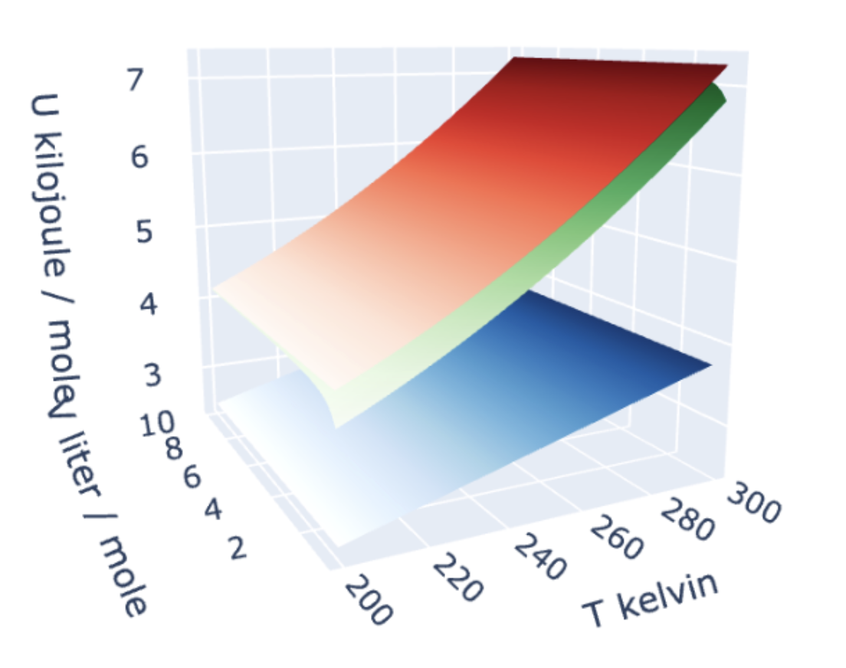
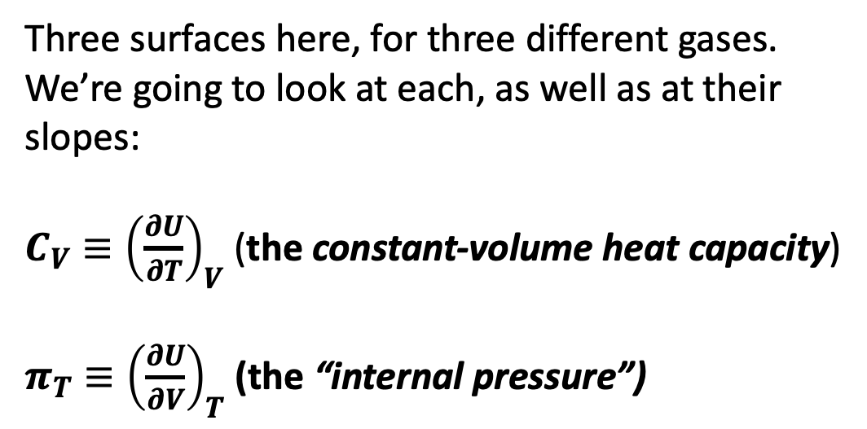

Visualizing $U(T,V)$ as a thermodynamic surface
$$U(T,V)$$
Three surfaces here, for three different gases. We’re going to look at each, as well as at their slopes:
${C_{V}≡\left(\frac{∂U}{∂T}\right)}_{V}$ (the constant-volume heat capacity)
${π_{T}≡\left(\frac{∂U}{∂V}\right)}_{T}$ (the “internal pressure”)

Slide 3
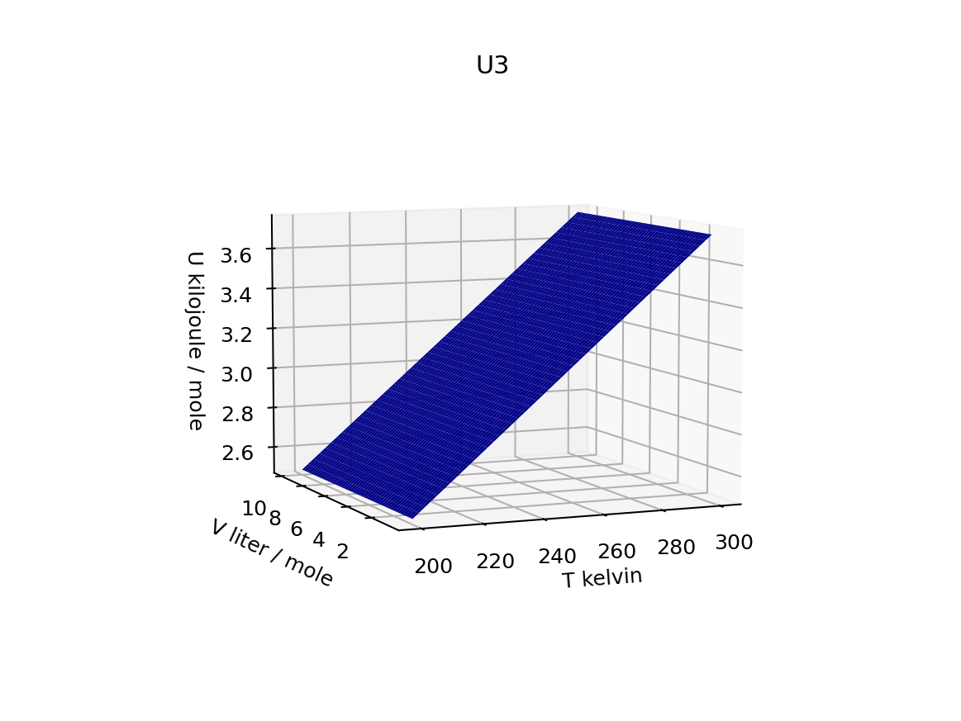
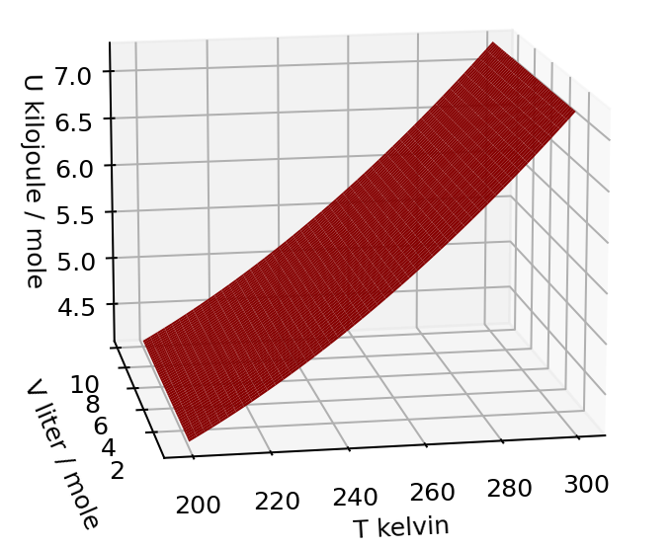
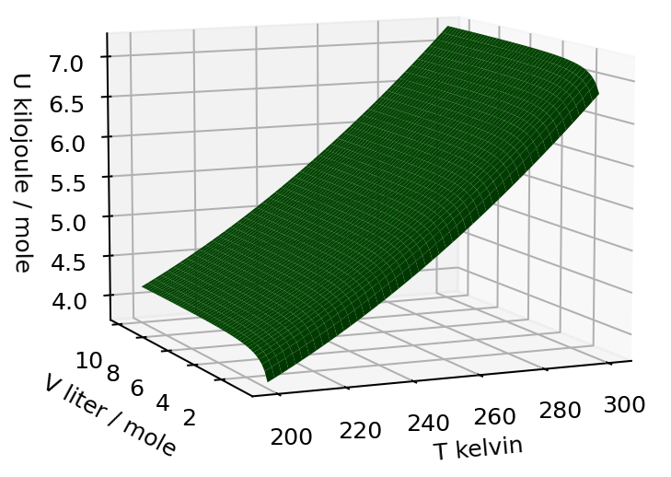
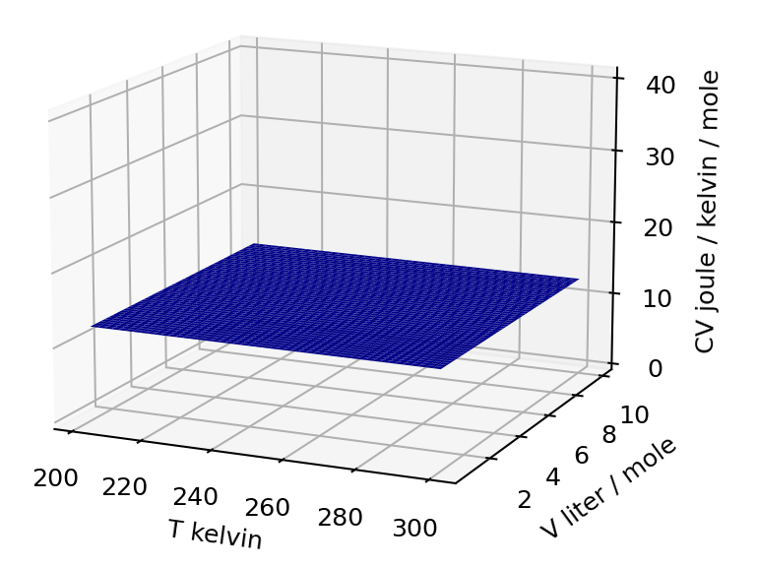
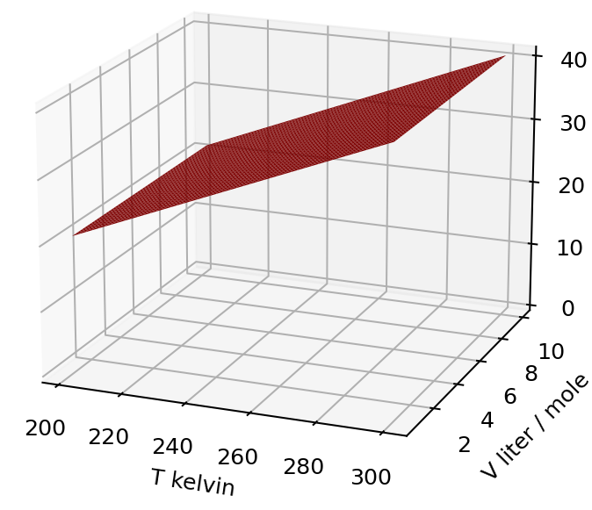
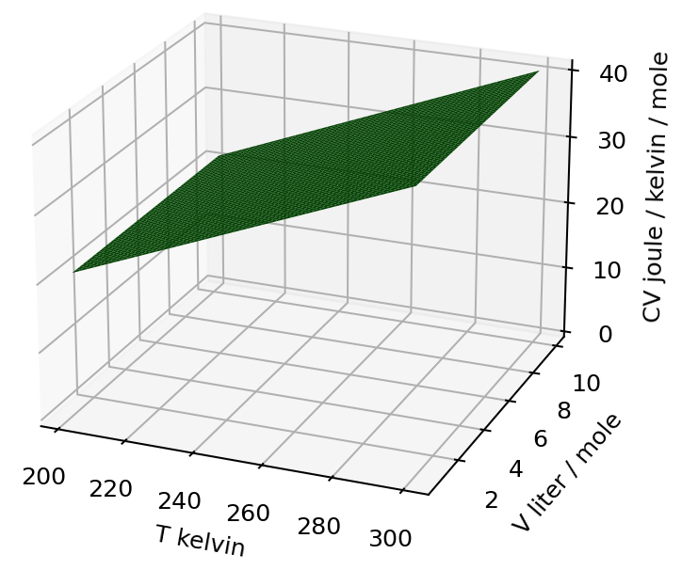


How $C_{V}$ varies
$$U(T,V)$$
$$C_{V}(T,V)$$
Constant slope heat capacity
Increasing heat capacity with higher temperature

Slide 4
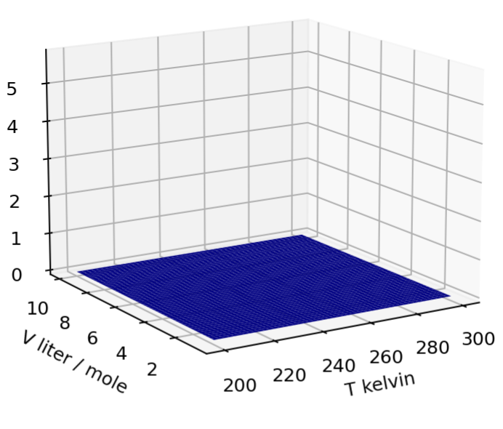
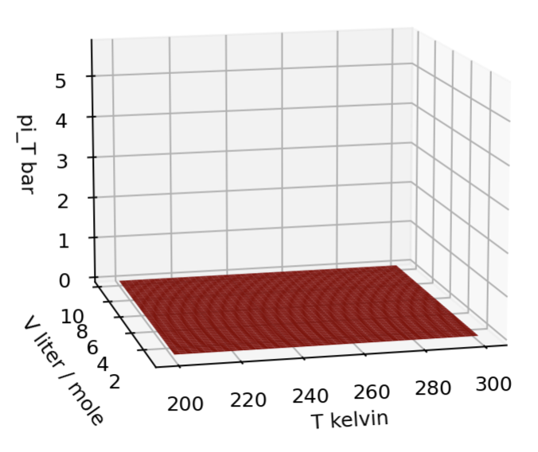
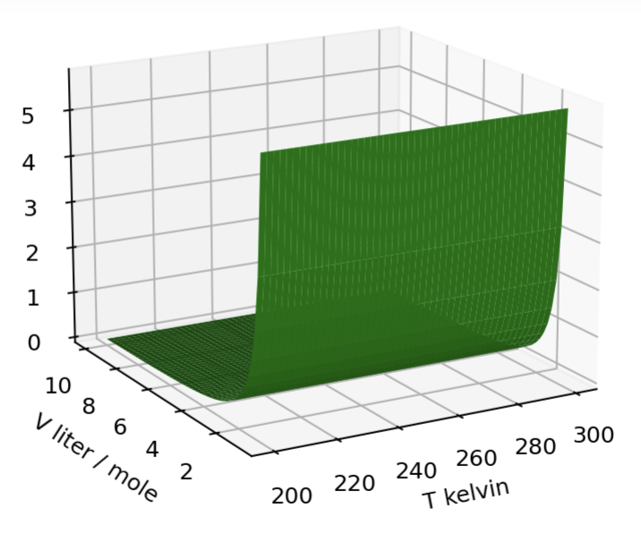

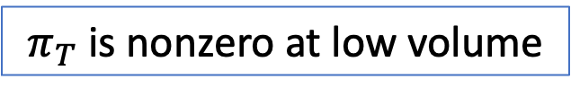

How $π_{T}$varies
$$U(T,V)$$
$$π_{T}(T,V)$$
$π_{T}$ is zero
$π_{T}$ is nonzero at low volume

Slide 5

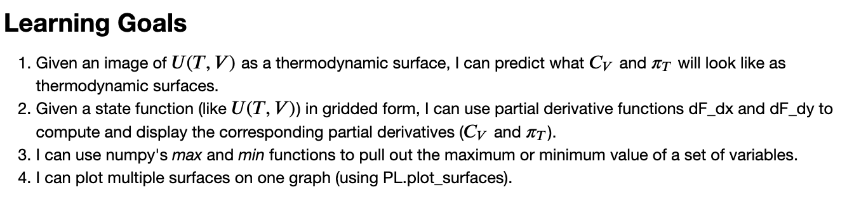
OK, let’s get started

